Slide 1

FORMULAS AND FUNCTIONS IN EXCEL 2021
Presented by Probir Sir

Slide 2

TOPICS COVERED
Introduction
Features of Excel
Applications of Excel
How to Open Excel
Overview of Excel
Entering Text
Inserting Cells, Columns, Rows
Data Types in Excel
Operators in Excel 2021
Operators Precedence
Ways to Enter a Formula in Excel 2021
Cell Range
Cell Reference
Functions

Slide 3

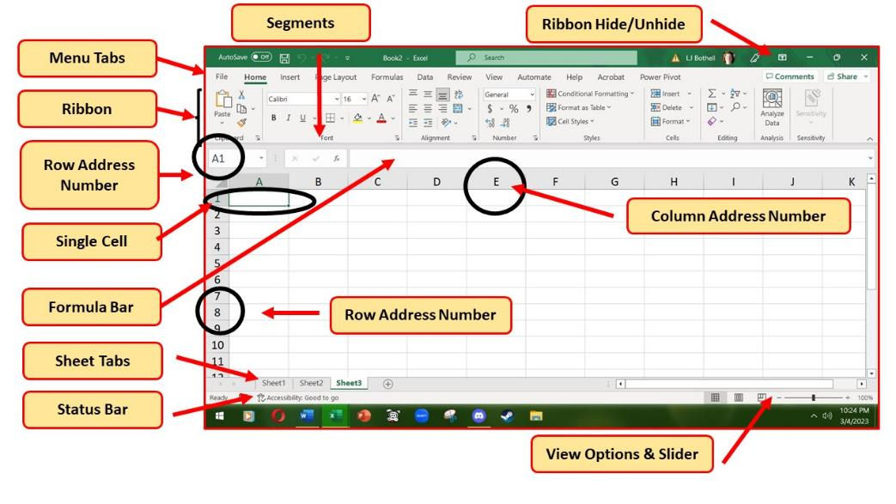
Introduction
Excel is a spreadsheet program developed by Microsoft, used for organizing, formatting, and calculating data.
Excel enables to perform various data analysis tasks, including mathematical functions, graphing, and pivot tables.
It is quite useful in entering, editing, analyzing and storing of data.
It performs numerous functions and formulas to assist you in your projects.

Slide 4
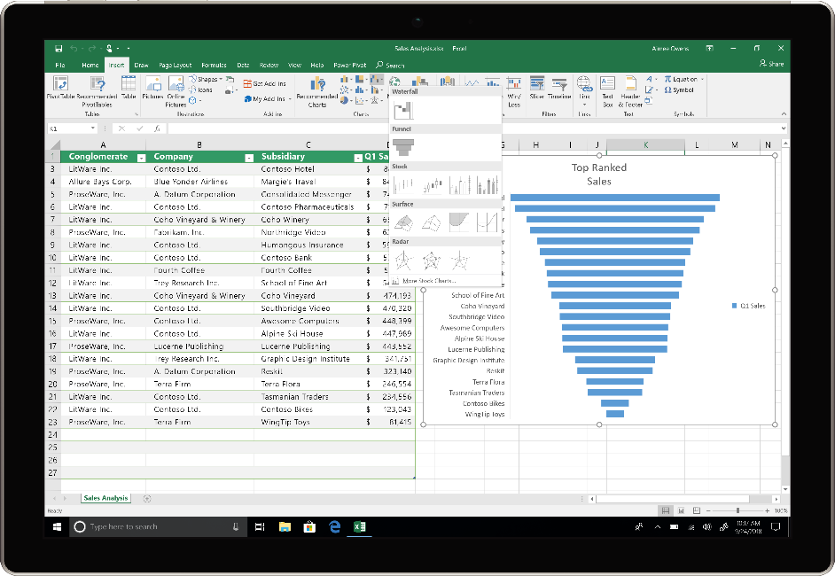
“They may forget what you said, but they will never forget how you made them feel.”
Features of Excel
– Carl W. Buechner
Spreadsheet Structure: Excel organizes data in a grid-like structure with rows and columns, creating cells where data is entered.
Data Manipulation: Users can input, edit, and format data within these cells.
Formulas and Functions: Excel supports a wide range of formulas and functions for performing calculations, statistical analysis, and other data manipulations.
Graphing and Charting: Users can create various charts and graphs to visualize data trends and patterns.
Sorting and Filtering: Data can be filtered and sorted in excel using filter and sort option.
Pivot Tables: Excel's pivot tables allow for dynamic data summarization and analysis.

Slide 5
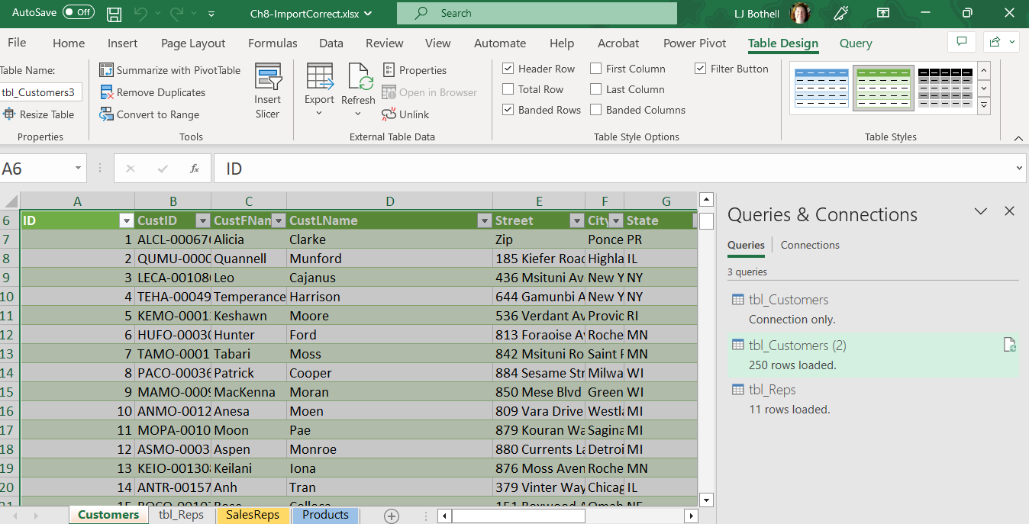
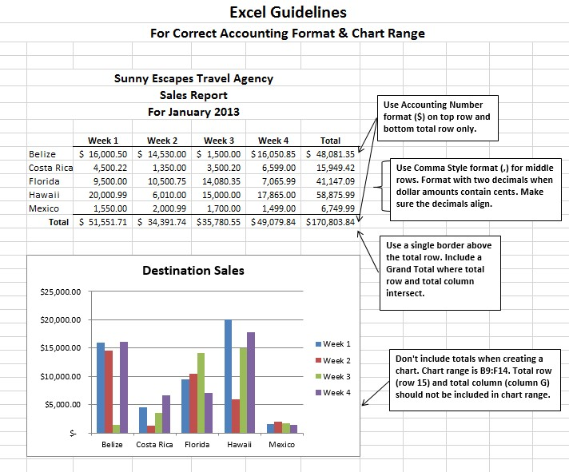
Applications of Excel
Data Organization: Excel is widely used for organizing and managing various types of data, including financial, sales, and project information.
Data Analysis: Excel is used for analyzing data to identify trends, patterns, and insights.
Financial Modeling: Excel is frequently used in financial modeling, forecasting, and budgeting.
Reporting: Excel can be used to create reports and dashboards for various business functions.
Data Visualization: Excel provides tools for creating visualizations of data, such as charts and graphs.

Slide 6
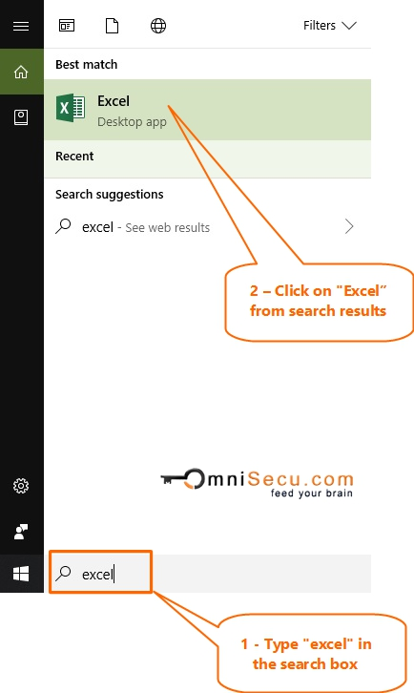
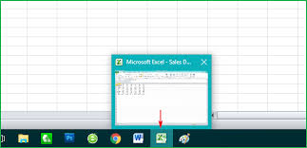
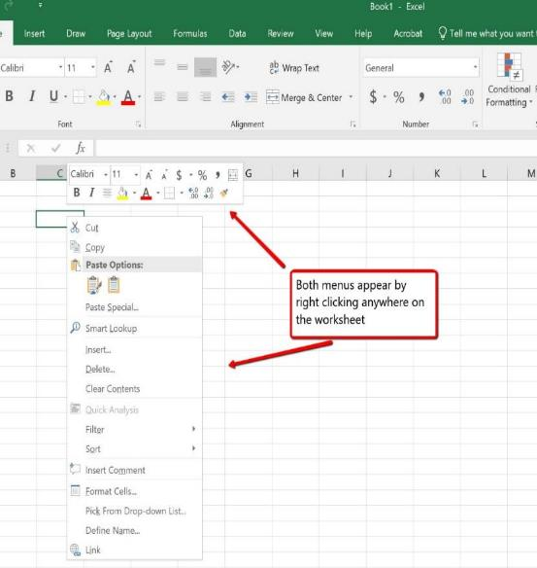
How to Open Excel
Click On the Search Box → type Excel
Excel icon appears → Click on the icon.
Or
Click on the Excel icon on the Taskbar
Or
Click on the Start Menu and search for the Excel icon
Click on the Excel icon.

Slide 7
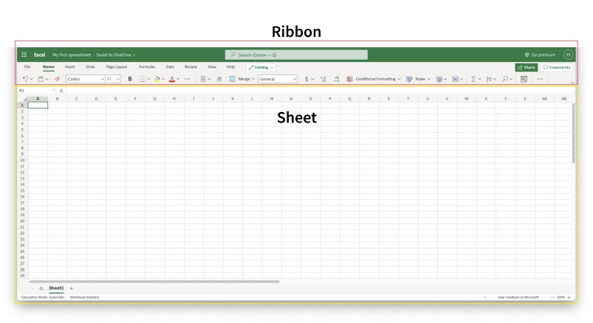
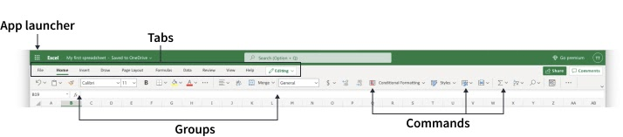
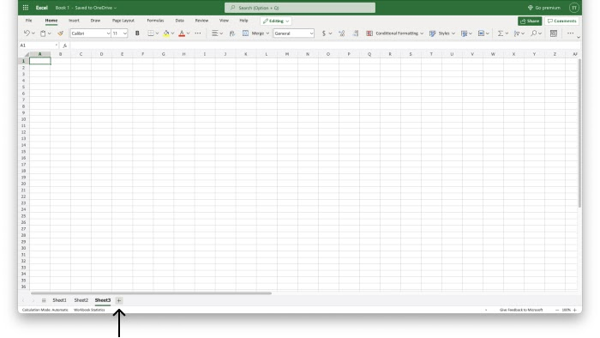
Overview of Excel
Excel's structure is made of two pieces, the Ribbon and the Sheet.
Ribbon provides shortcuts to Excel commands. The Ribbon is made up by the App launcher, Tabs, Groups and Commands.
A workbook is essentially an Excel file that can contain one or more worksheets.
Each worksheet is a separate page within the workbook. The Work Sheet is a set of rows and columns.
Intersection of columns and rows are known as cells.

Slide 8

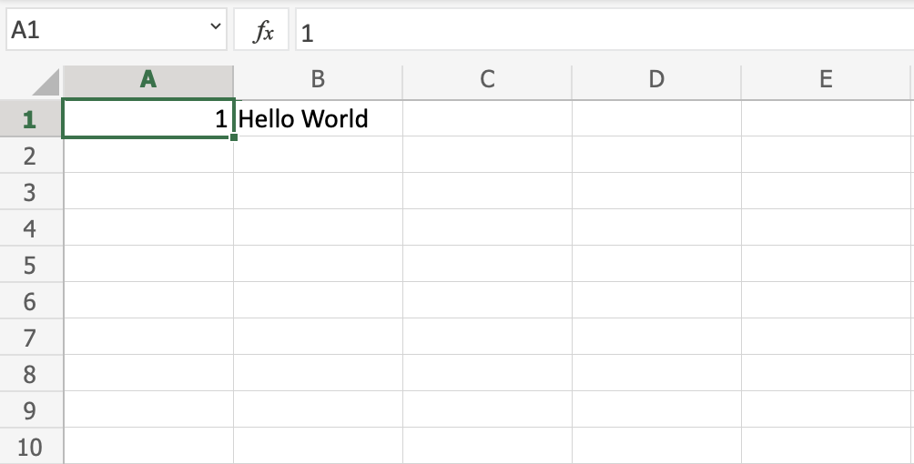
Entering Text
In Excel 2021, a worksheet contains 1,048,576 rows and 16,384 columns. This has been the standard limit since Excel 2007.
Excel workbooks typically have a .xlsx file extension.
Create a new workbook by selecting "New" or "Blank workbook" in Excel.
A cell can contain a value, a formula, or a text entry. A text entry is used to label or explain the contents or the value of a formula.
Manual Data Entry: Click on the cell, type any text, Press Enter or Tab key. Press Alt + Enter to enter a new line.
Using the Formula Bar: Select a cell, enter data in the formula bar, press enter key.
Excel's "Fill Handle" feature can automatically fill in a series of data in a column or row based on a pattern you establish.

Slide 9
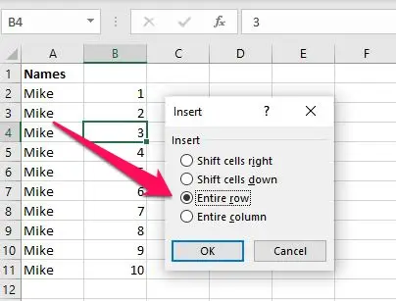
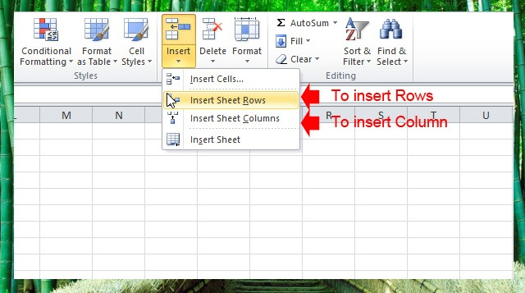
Inserting Cells, Columns, Rows
When we create a worksheet in Excel, we frequently need to move the cells. That is done through insertion and deletion of cells, columns, rows.
Inserting Cells: Select the Cell → Right-click and choose Insert → Select Shift cells right or Shift cells down.
To add or remove a cell, you can go to the Home menu, look in the Cells grouping of commands and click on Insert to add or Delete to remove.
To insert rows: Select the row(s) above which you want to insert new rows → Right-click on the selection and choose Insert. Alternatively, select a cell in the row above where you want to insert, go to the Home tab, click "Insert", and then select "Insert Sheet Rows" .
To insert columns: Select the column(s) to the right of where you want to insert new columns → Right-click on the selection and choose Insert. Alternatively, select a cell in the column to the left of where you want to insert, go to the Home tab, click "Insert", and then select "Insert Sheet Columns“.

Slide 10
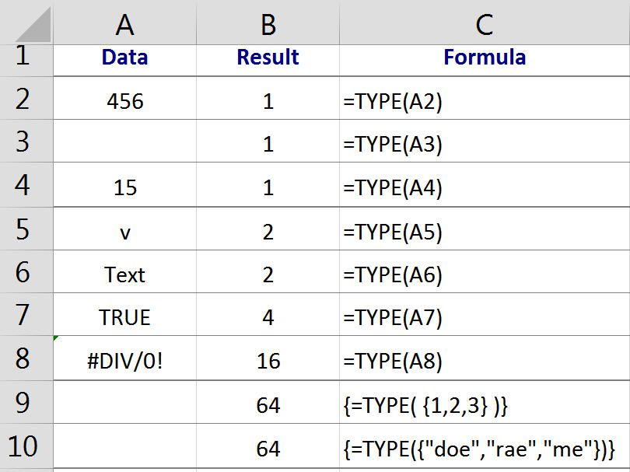
Data Types in Excel
Label:
Any text entered in Excel is called a label.
Heading of a column, title, name.
Alphabetic, Alphanumeric, symbols, characters, numbers and spaces.
Always left align.
Mathematical calculations cannot be performed.
Value:
Any numeric Data including whole numbers (integers), decimal numbers, and currency values.
Mathematical calculations are possible.
Values are always right aligned.
Formatting options allow you to display numbers as currency, percentages, or in other formats.
Formula:
An expression that operates on the value or a range of cells and generate a result.
To perform mathematical calculations, formula is entered in a cell.
References: A cell or a range of cells that is to be used in the calculations.
Operators: Symbols like +, -, *, /, ^, $, %, etc. that specify the calculations to be performed.
Constants: Numbers or values that do not change.
A Formula must begin with an ‘=‘ sign.
Operators must be included to direct the operation.
The data can be either numbers or cell addresses.
A formula can contain a maximum of 8,192 characters in length.

Slide 11
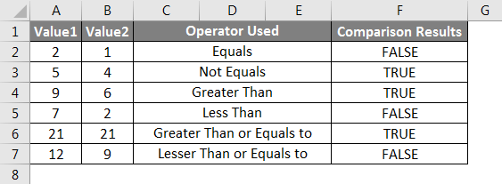

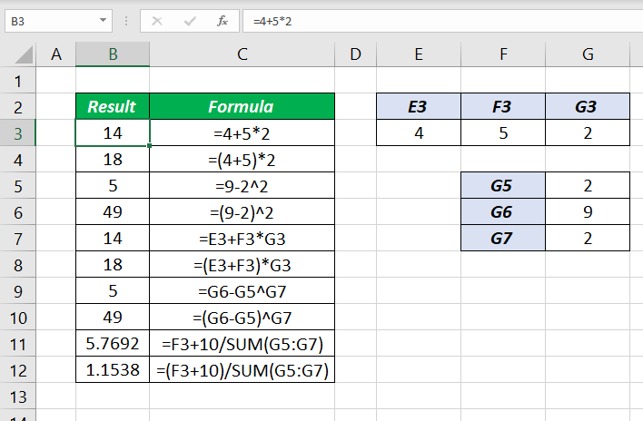
Operators in Excel 2021
In Excel, operators are symbols that tell the software what type of calculation to perform. There are three main types of operators: arithmetic, comparison, and reference. Text concatenation is another type.
Arithmetic Operators:
+ Addition
- Subtraction
* Multiplication
/ Division
^ Exponentiation
% Percentage
Comparison Operators:
= Equals to
> Greater than
>= Greater than or equal to
< Less than
<= Less than or equal to
<> Not equal to
Reference Operators:
: Colon – Creates a range of cells.
, Comma – Union of multiple cell or range references.
‘ ’ Space – Intersection of two cell or range references.
Text Concatenation Operator:
& Combines two text strings

Slide 12
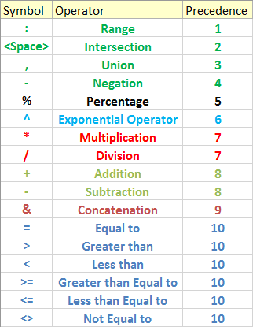
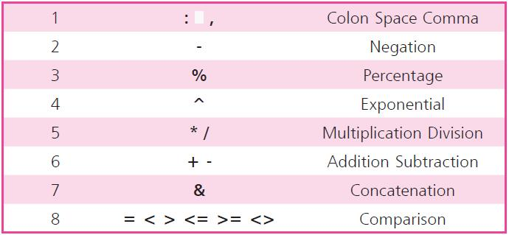
In Excel, operator precedence determines the order in which operations are performed within a formula. The general order, from highest to lowest precedence, is: parentheses, exponentiation, multiplication and division, addition and subtraction, concatenation, and comparison.
Operators Precedence

Slide 13
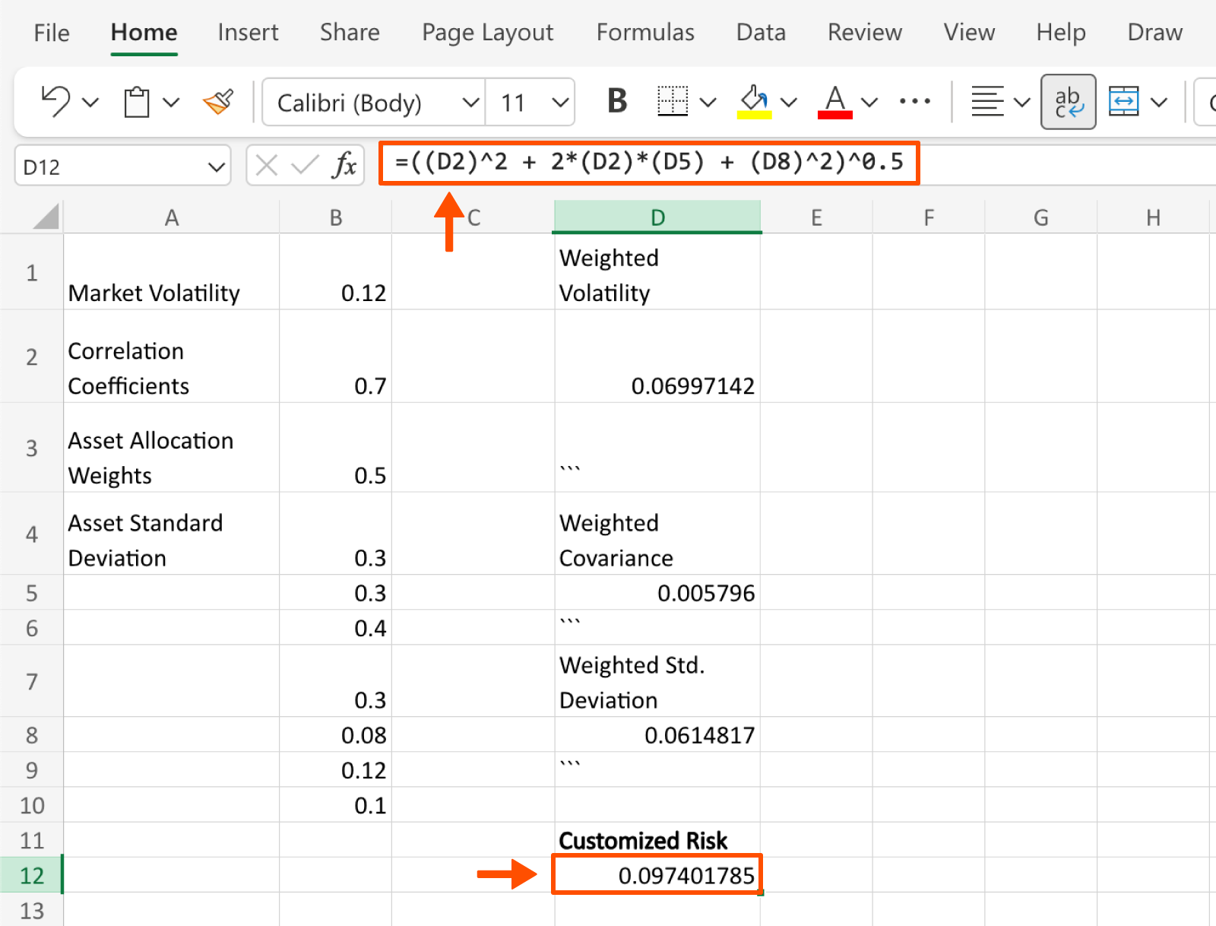
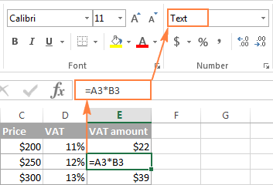
Ways to Enter a Formula in Excel 2021
Enter a Formula directly into the cell:
Enter a formula into the cell after typing an equals ‘=’ sign, press the Enter key to see the result.
Enter a Formula in the formula bar:
Select the cell and enter the formula in the formula bar after typing an equal to sign, press Enter key to see the result.
Always enter a formula as per BODMAS rule for accurate result.

Slide 14

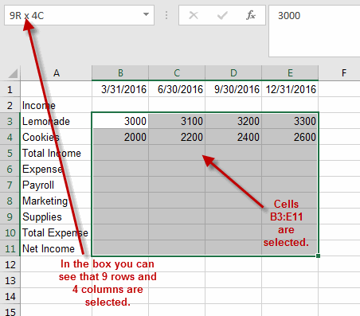
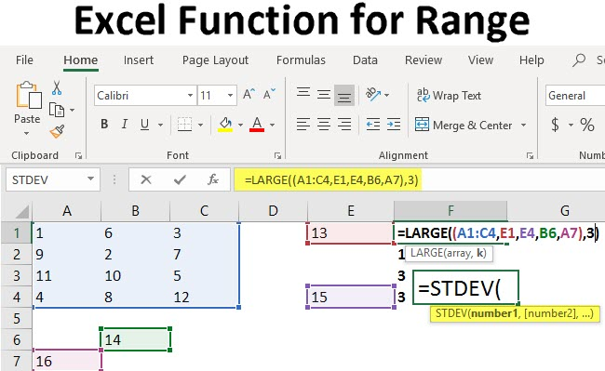
Cell Range
In Excel, a cell range refers to a group of two or more cells, either contiguous or non-contiguous, that are selected or defined for use in formulas, calculations, or other operations. A range is commonly defined by the top-left and bottom-right cells of the selection, separated by a colon ‘ : ’, e.g., =SUM(A1:A5).
A contiguous range consists of cells that are directly next to each other, forming a rectangle or square.
A non-contiguous range, on the other hand, can include cells that are not adjacent, for example, by using the CTRL key while selecting individual cells.
Selecting Ranges:
Ranges can be selected by dragging across cells, using the SHIFT key with arrow keys, or using keyboard shortcuts like CTRL+SHIFT+END to select the range to the last used cell.

Slide 15
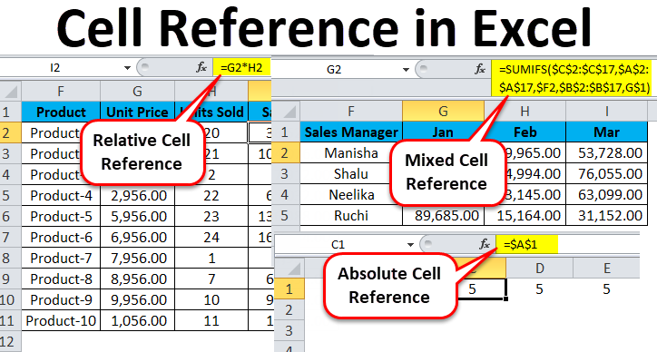
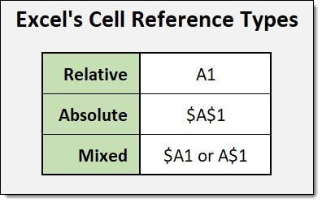
Cell Reference
A cell reference is a way to identify a specific cell on a worksheet, used in formulas to point to the data in that cell.
It's essentially the cell's address, like A1 or B2.
A cell reference is formed by the column letter (e.g., A, B, C) and the row number (e.g., 1, 2, 3). For example, A1 refers to the cell in the first column (A) and first row (1).
Relative references: These are the most common type. When you copy a formula containing a relative reference, the cell reference will adjust based on the new cell's position. For example, if you copy the formula =A1 from cell B2 to cell C3, it will become =B2.
Absolute references: These are used when you want to keep a specific cell reference constant, even when you copy the formula. You indicate an absolute reference by adding a dollar sign ($) before both the column and row in the cell reference (e.g., $A$1). For example, if you copy the formula =$A$1 from cell B2 to cell C3, it will still refer to cell A1.
Mixed references: These allow you to fix either the column or the row, but not both. For example, $A1 would fix the column A, but allow the row to change, while A$1 would fix the row 1, but allow the column to change.

Slide 16
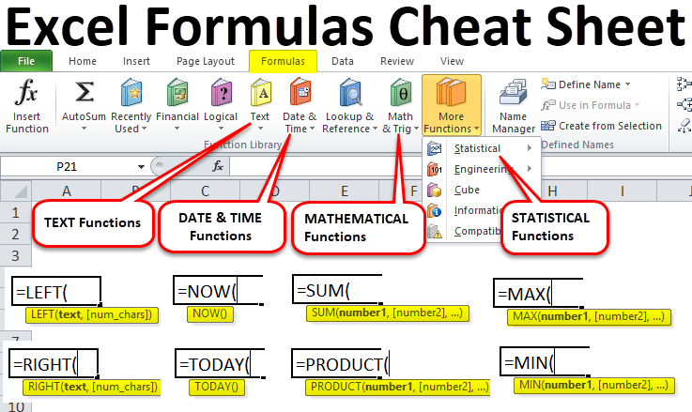
Functions
Excel functions are predefined formulas that perform calculations using specific values (arguments) in a particular order. They are a powerful tool for automating calculations, data analysis, and more. You can find a wide variety of functions in Excel, ranging from basic arithmetic operations to complex statistical and financial analyses.
Arguments are inputs to the functions. The values should be given in between the parentheses. E.g. =sum(A1:A5). Sum is the function and A1 and A5 are arguments.
All the excel functions begin with ‘=’ sign.
A function name must be a valid Excel name.
A function must be followed by the opening and closing parentheses.
Most of the functions must contain at least one argument within it.

Slide 17
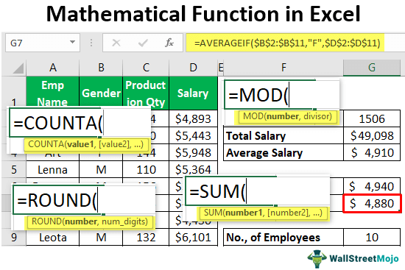
Mathematical Functions
Function | Purpose | Example
SUM(range) | Returns the sum of a range. | =sum(4,8,12,16), result 40.
PRODUCT(range) | Multiplies the values in a range of cells. | =product(4,2,8), result 64.
MOD(number, divisor) | Returns the remainder after a number is divided by the divisor. | =mod(8,5), output 3.
SQRT(number) | Returns the square root of the given number. | =sqrt(81), output 9.
INT(number) | Rounds the number to an integer value. | =int(14.25), output 14.
POWER(number, power) | Returns the result of a number. | =power(5,3), output 125.
ROUND(number, number of digits) | Returns a number after rounding to the specified digits. | =rounds(35.6666,2), output 35.67
ABS(number) | Returns the absolute value of a given number. | =abs(-25), output 25

Slide 18
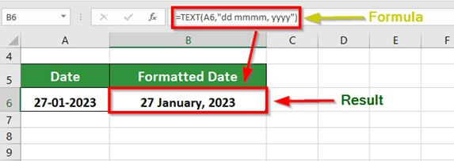
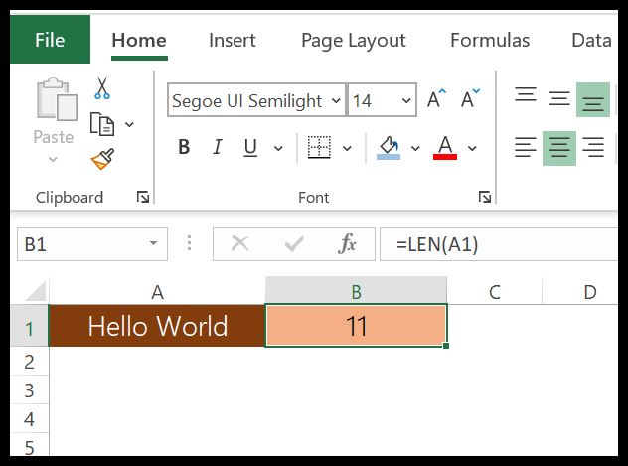
Text Functions
Function | Purpose | Example
CONCATENATE(text1, text2) | Joins together two or more different text strings. | =concatenate (“Track”, “pad”), output Trackpad.
LEFT(text, num_chars) | Returns the specified number of characters from the start of the text string. | =left(“Track”, 3), output Tra.
RIGHT(text, num_chars) | Returns the specified number of characters from the end of the text string. | =right(“Track”, 3), output ack.
LEN(text) | Returns the length of the text string. | =len(“Track”), output 5.
UPPER(text) | Converts the text string into UPPERCASE. | =upper(“Track”), output TRACK.
LOWER(text) | Converts the text string into lowercase. | =lower(“Track”), output track.

Slide 19
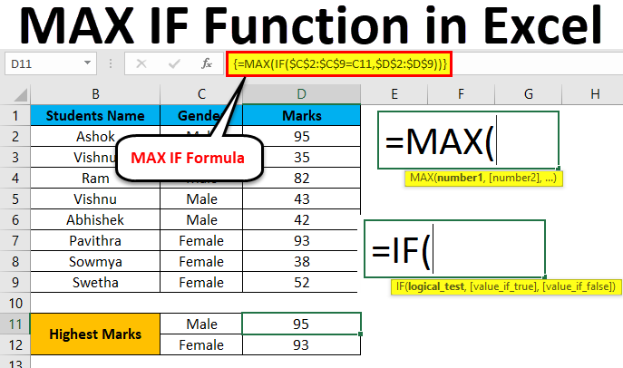
Statistical and Logical Functions
Function | Purpose | Example
MAX(range) | Returns the largest value in the given range. | =max(4, 6, 12, 16), output 16.
MIN(range) | Returns the smallest value in the given range. | =min(3,5,7,8), output 3.
AVERAGE(range) | Returns the average of a range of numbers. | =average(10,12,14), output 12.
COUNT(range) | Returns the count of the number of values in the selected range. | =count(4,8,12), output 3.
IF(condition, value1, value2) | Checks whether the given condition is met and returns value if the condition evaluates to true and returns value2 if the condition evaluates to false. | =if(percentage>=50,”Passed”,”Failed”), output Passed.

Slide 20
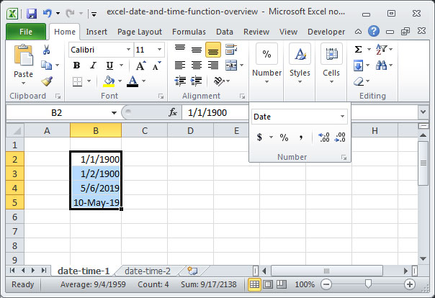
Date and Time Functions
Function | Purpose | Example
TODAY() | Returns the current date. | =today(), output 02.05.2025.
MONTH(TODAY()) | Returns the current month. | =month(today()), output 5.
YEAR(TODAY()) | Returns the current year. | =year(today()), output 2025.
DAY(TODAY()) | Returns the current day. | =day(today()), output 2.
NOW() | Returns the current system date and time. | =now() output 02.05.2025 10:00.
HOUR(time) | Returns the hour from a given time. | =hour(now()) output 10;
MINUTE | Returns the minute from a given time. | =minute(now()) output 00.

Slide 21
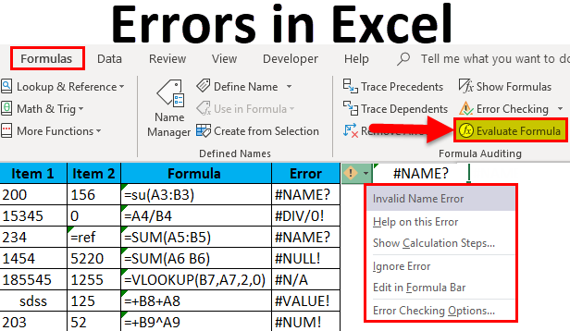
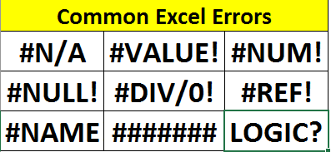
Common Errors in Functions
##### : Appears when the column width is not wide enough to display the cell's content. Adjust the column width to fix it.
#DIV/0!: Occurs when a formula tries to divide by zero. To adjust take a non zero divisor.
#VALUE!: Occurs when Excel expects a number but finds text, or vice versa. Adjust the data type.
#N/A: Indicates that a lookup function couldn't find the value it was searching for.
#NAME?: Appears when Excel doesn't recognize a function name in your formula. Spelling Check.
#REF!: Occurs when a cell reference in a formula is no longer valid (e.g., due to a deleted cell).
#NUM!: Indicates an invalid numerical value in your formula.

Slide 22
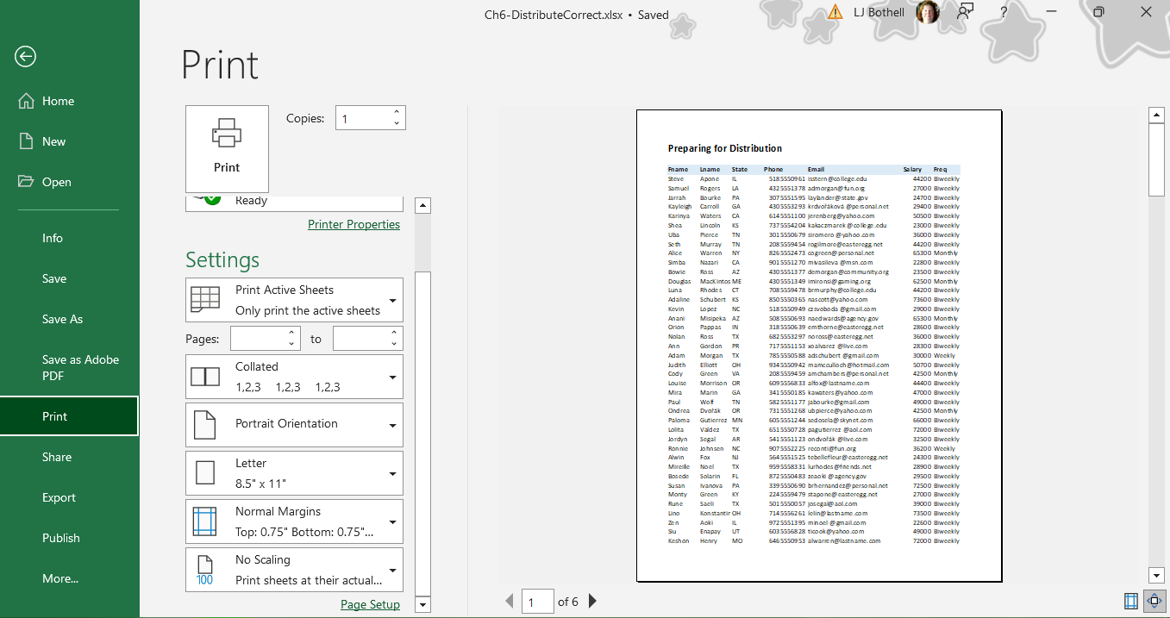

MS Excel is the best spreadsheet application software to manage, control huge amount of data. To generate report it is unparallel. The graphics and chart representation of data is also outstanding. That is why Excel is the most popular and state of the art software.

